Slide 1

University Institute of Engineering
DEPARTMENT OF COMPUTER SCIENCE & ENGINEERING
Bachelor of Engineering (Computer Science & Engineering)
Subject Name : SEO
Subject Code: 20CST-463
Topic: Lecture-1.3.3
Lecture- Local SEO
By : Sourabh Budhiraja
DISCOVER . LEARN . EMPOWER

Slide 2
Syllabus
UNIT-1: Introduction to SEO
CHAPTER-1: Introduction to Search Engine Optimization:
Introduction to search engine optimization, Basics of SEO, Keyword Research, On-Page Optimization, Technical SEO.
CHAPTER-2: Content Creation and SEO tools:
Content Creation for SEO, SEO Analytics, SEO Tools, Local SEO, SEO Ethics and Future Trends.

Slide 3
CONTENTS
Local SEO

Slide 4
What is Local SEO?
Local SEO is the process of optimizing your online presence to increase local traffic, visibility, and brand awareness.
Common local SEO tasks include:
Optimizing your Google Business Profile
Finding local keywords
Creating locally relevant content
And any business that has a physical location or serves a geographic area can benefit from local SEO.
This is an example of a local search result on Google:

Slide 5
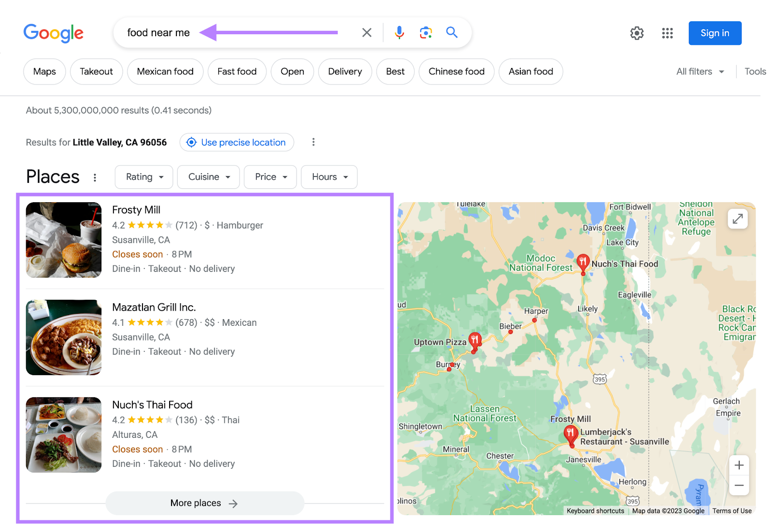
What is Local SEO?
This is an example of a local search result on Google:

Slide 6
Why Is Local SEO Important?
The best way to get your site in front of people in your area is to use local SEO marketing. Over 75% of consumers in the United States, France, Germany, and the United Kingdom use Google when looking for business information. Making it the most dominant search engine for local search in those (and many other) countries. By far. And Google Maps searches for “shopping near me” have grown globally by more than 100% year over year. Mobile searches for “store open near me” also grew by over 250% in a recent two-year period. And “where to buy” + “near me” keywords by more than 200%. That’s hundreds of millions of searches every day.

Slide 7
How Local SEO Works
On top of Google’s usual ranking factors, its local search algorithms use three main factors to help find the best match: Relevance (how closely related a Google Business Profile result is to the words a searcher uses in their query)Distance (how far Google believes a user is from a business when they search)Prominence (how important Google thinks a business is to its potential customers)
Google displays two types of search results for local searches.
The “local pack” results (Google Maps and Business Profiles) and organic results.
Organic results are the “normal” blue link search results we’re all used to seeing on Google.
A local pack (or map pack) is a Google feature that shows the top local business listings and a map.

Slide 8
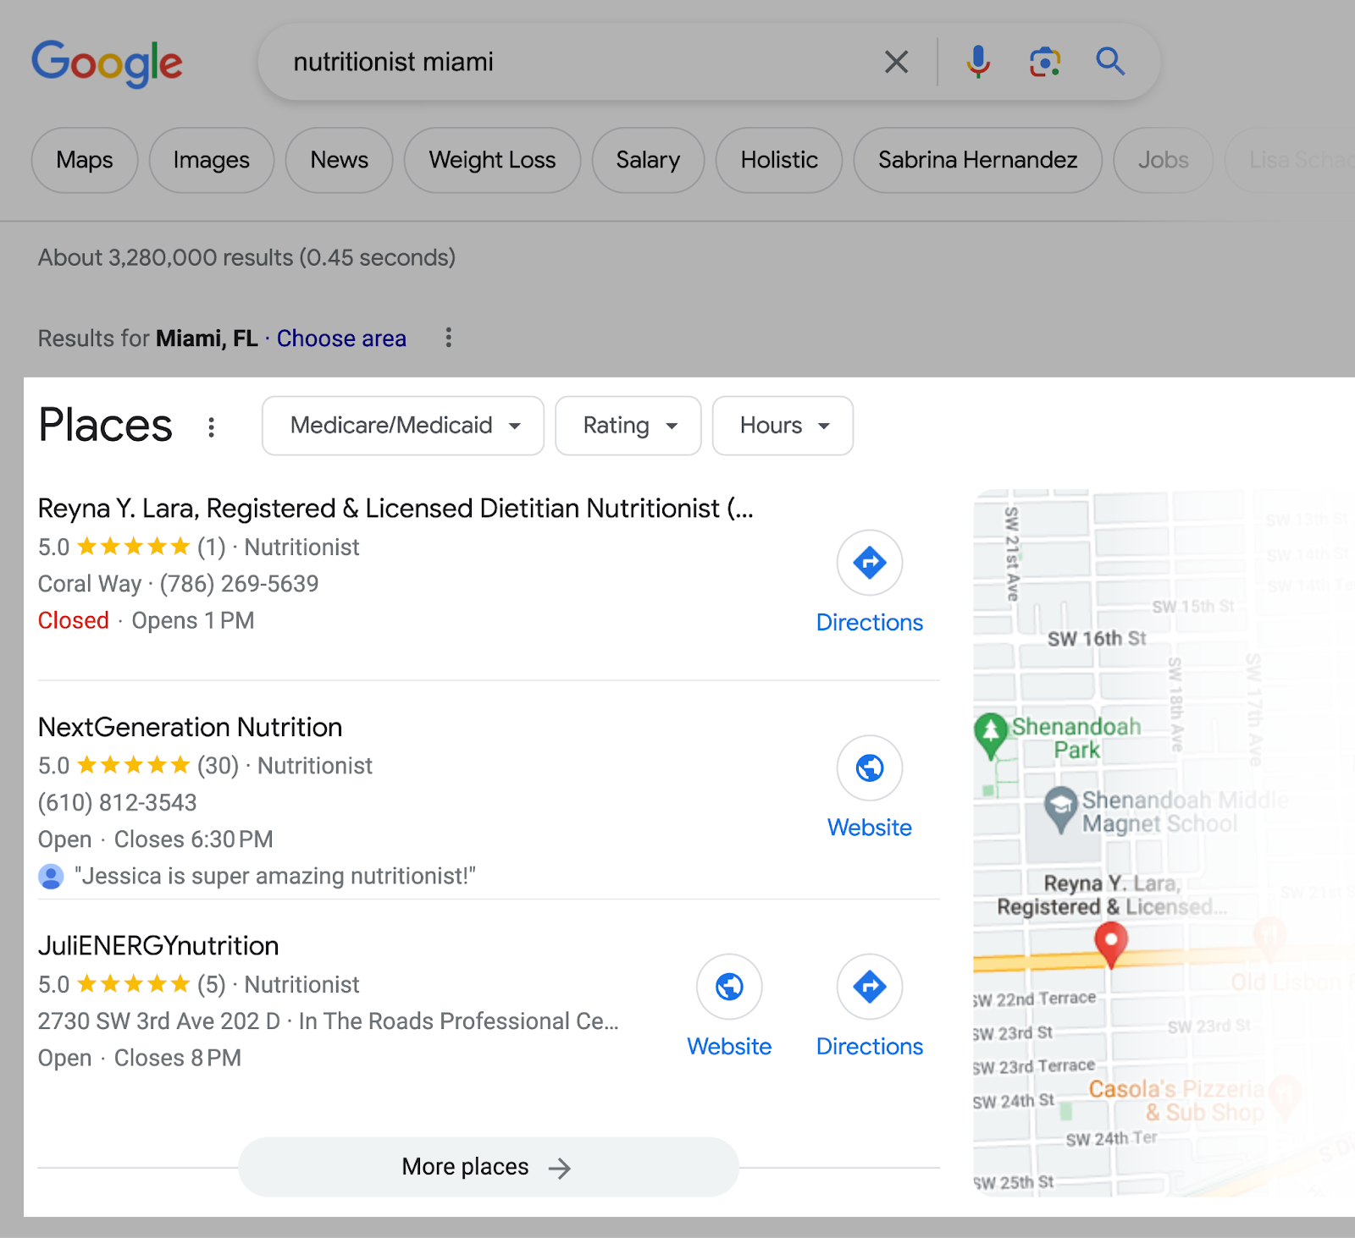
How Local SEO Works
For example, when you search for “nutritionist miami,” Google displays a local pack at the very top.

Slide 9
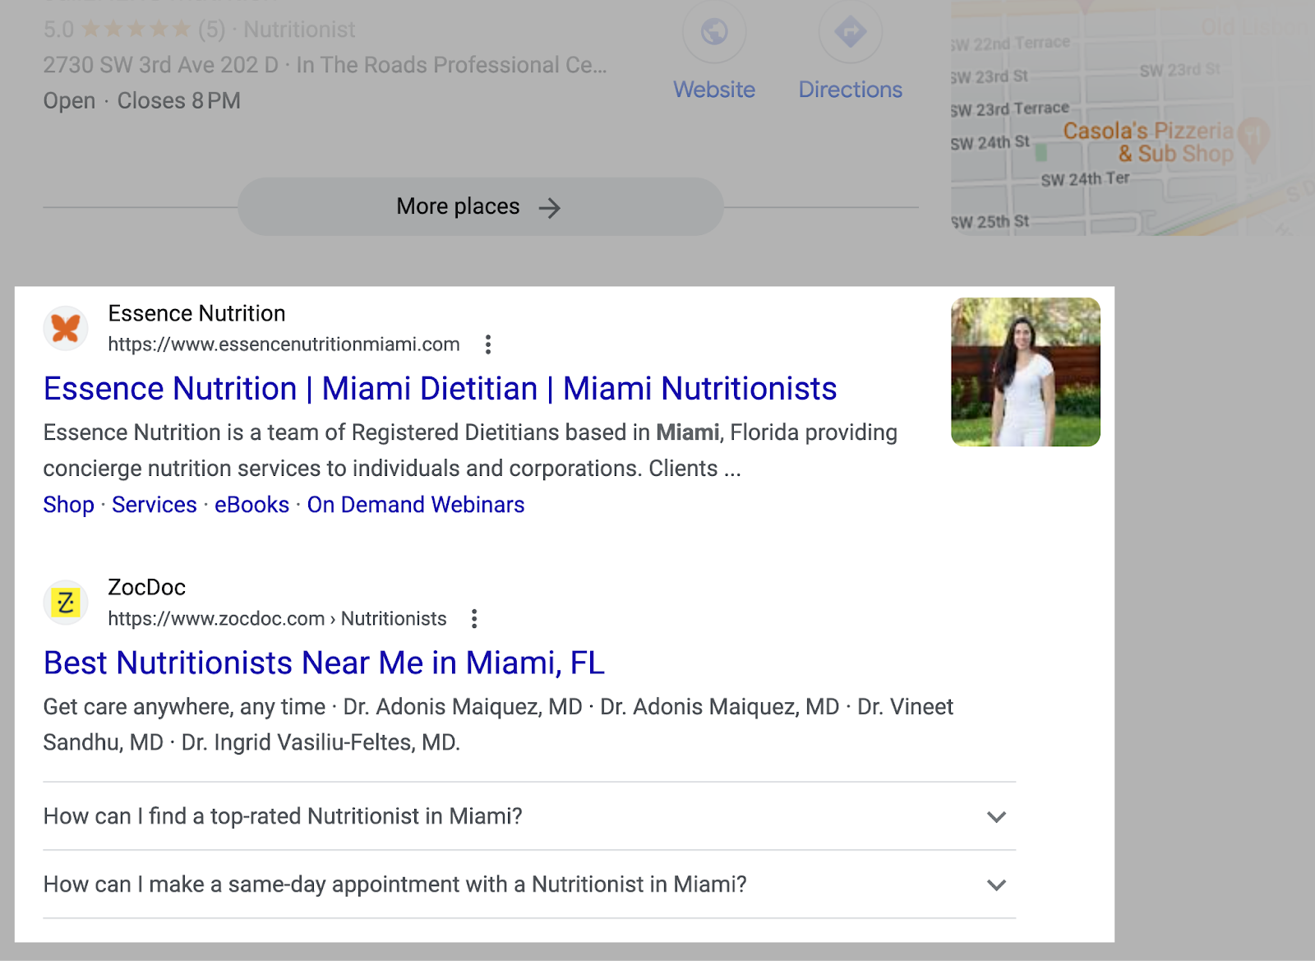
How Local SEO Works
And the “regular” organic results underneath.

Slide 10
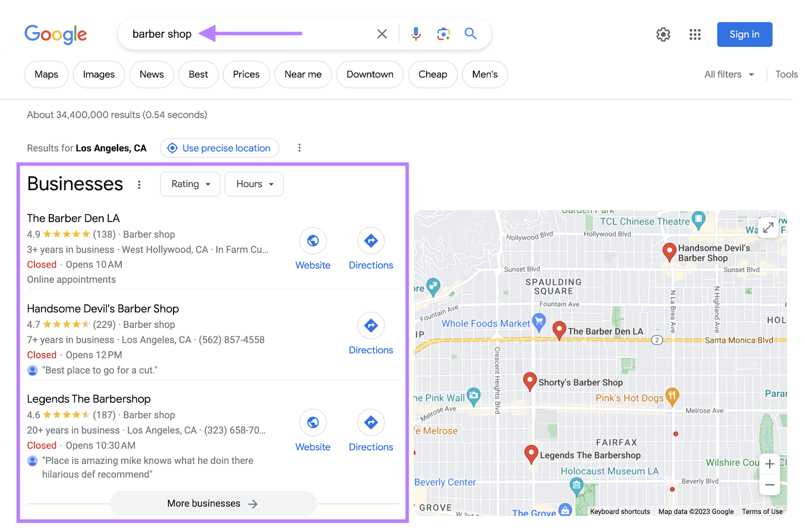
How Local SEO Works
But Google doesn’t just display local results for queries that contain a city, state, or “near me” keyword. If Google believes the intent of your search is local, it’ll display local results . Even if your search isn’t explicitly local. For example, if you were in Los Angeles and searched for “barber shops,” Google would still display a local pack for Los Angeles barber shops. Like this:

Slide 11
How to Do Local SEO
Do Local Keyword Research
Keyword research for local SEO is the process of finding keywords people use when searching for local products and services. Ranking for these keywords drives highly targeted local traffic to your site and sends more customers your way. To get started, you need a short list of keywords people can use to find your local business.
Research Your Competitors
Seeing what your competitors are doing is an easy way to start gathering ideas. One of the best ways to do that is to use SEMrush's Organic Research tool.
Enter a competing site and click “Search.”
Then, go to the “Positions” tab.
Click on “Advanced filters,” and exclude branded keywords (phrases that contain your competitor’s business name).

Slide 12
How to Do Local SEO
Research Your Competitors
And click the “KD%” column to sort the table by keyword difficulty.
Check Local Keyword Volume Metrics
You’ll also want to get a sense of how difficult it is for your content to rank locally for keywords you choose to target. Use the local volume metrics feature in the Keyword Overview tool to identify valuable keywords you’ll want to target in your content.
Enter your desired keyword into the search bar at the top of the page and hit “Search.”
Once the tool delivers the keyword results, click on the drop-down bar labeled “Select location.”

Slide 13
How to Do Local SEO
Research Your Competitors
Type in your locale. This could be a state, county, province, city, or municipality. Go as narrow on the location as you wish.
Use Google Autocomplete
Google autocomplete is a feature within Google Search that makes it faster to complete searches when you start to type. Its purpose is to save users time by predicting what they’re going to search for. And it can help you discover valuable long-tail keywords for local SEO.

Slide 14
How to Do Local SEO
Research Your Competitors
Type in your locale. This could be a state, county, province, city, or municipality. Go as narrow on the location as you wish.
Use Google Autocomplete
Google autocomplete is a feature within Google Search that makes it faster to complete searches when you start to type. Its purpose is to save users time by predicting what they’re going to search for.And it can help you discover valuable long-tail keywords for local SEO.
Leverage Google Keyword Planner
Google’s Keyword Planner helps you research keywords for paid search campaigns.
But it’s also great for discovering new keywords related to your business.
Start by going to the “Discover new keywords” section.

Slide 15
How to Do Local SEO
Click on the “Start with a website” tab. Then, enter the domain of one of your competitors.
Click “Get results,” and Google will suggest a ton of keywords based on the terms that appear on that page.
Repeat the process with three of your top competitors and add all the relevant keywords to your list.
Optimize Your Google Business Profile
A Google Business Profile (formerly Google My Business) is a free business listing with information about your business. It allows you to provide details like your location, services, products, and photos.

Slide 16
How to Do Local SEO
Get Local (NAP) Citations
NAP citations are places that mention your name, address, and phone number (NAP) online.
They usually appear on business directories and social media profiles.
Encourage Online Reviews
Reviews and testimonials build customer trust.They provide social proof, validate your expertise, and give potential buyers confidence in your business.
Refine Your On-Page SEO
On-page SEO is the practice of optimizing your website pages to help them rank higher on organic search results. And it’s indispensable for local search engine marketing. If you rank well organically, you likely have strong chances of ranking in the local pack.

Slide 17
How to Do Local SEO
To run a quick audit and gauge your on-page SEO health, use Semrush’s On Page SEO Checker.
Enter your domain, hit “Get ideas,” and the tool will automatically start running an audit.
After a few minutes, it’ll display a dashboard with different on-page factors for you to optimize.
If you scroll down, you’ll see your pages are conveniently sorted by “priority.”
Optimize these pages first to get the most impactful results.
Click on the “# ideas” button beside each of the top pages to optimize to get more specific optimization ideas.

Slide 18
How to Do Local SEO
To run a quick audit and gauge your on-page SEO health, use Semrush’s On Page SEO Checker.
Here are a few on-page SEO tips:
Include your locally targeted keywords in page titles and meta descriptions
Add specific location pages to your website to emphasize your local services
Internally link to and from pages where relevant
Build Backlinks
Backlinks are links on other sites that link back to yours.
They’re one of the strongest ranking signals in Google’s search algorithm.

Slide 19
How to Do Local SEO
Monitor Local Listings
Getting your business on directories is important. But so is monitoring them. Especially as your number of listings grows.
Start by searching for your business and selecting it from the list.
You’ll see your overall “Online Presence” score, “Total Listings,” “Listings to Fix,” and “Average Star Rating.”
Scroll down to see the listings with inaccurate or inconsistent information.
Solve these issues as quickly as possible. And check back every month to fix any problems that might’ve popped up.

Slide 20
Local SEO Tools
Google Search Console
Search Console is a free Google local SEO tool that helps monitor, maintain, and fine-tune your site’s presence in search results. It’s a great tool to understand how Google sees your pages and ensure your site is crawlable.
Semrush’s Listing Management
Listing Management is Semrush’s all-in-one local SEO tool that helps manage and distribute your business information. You can easily add your business NAP (name, address, phone), submit to dozens of directories, and keep track of all your customer reviews.

Slide 21
Local SEO Tools
Semrush’s Position Tracking
The Position Tracking tool’s most important feature for local SEO is monitoring keywords and rankings on a ZIP code level and in local packs. It also enables you to stay on top of changes in position and keep an eye on your competitors.

Slide 22
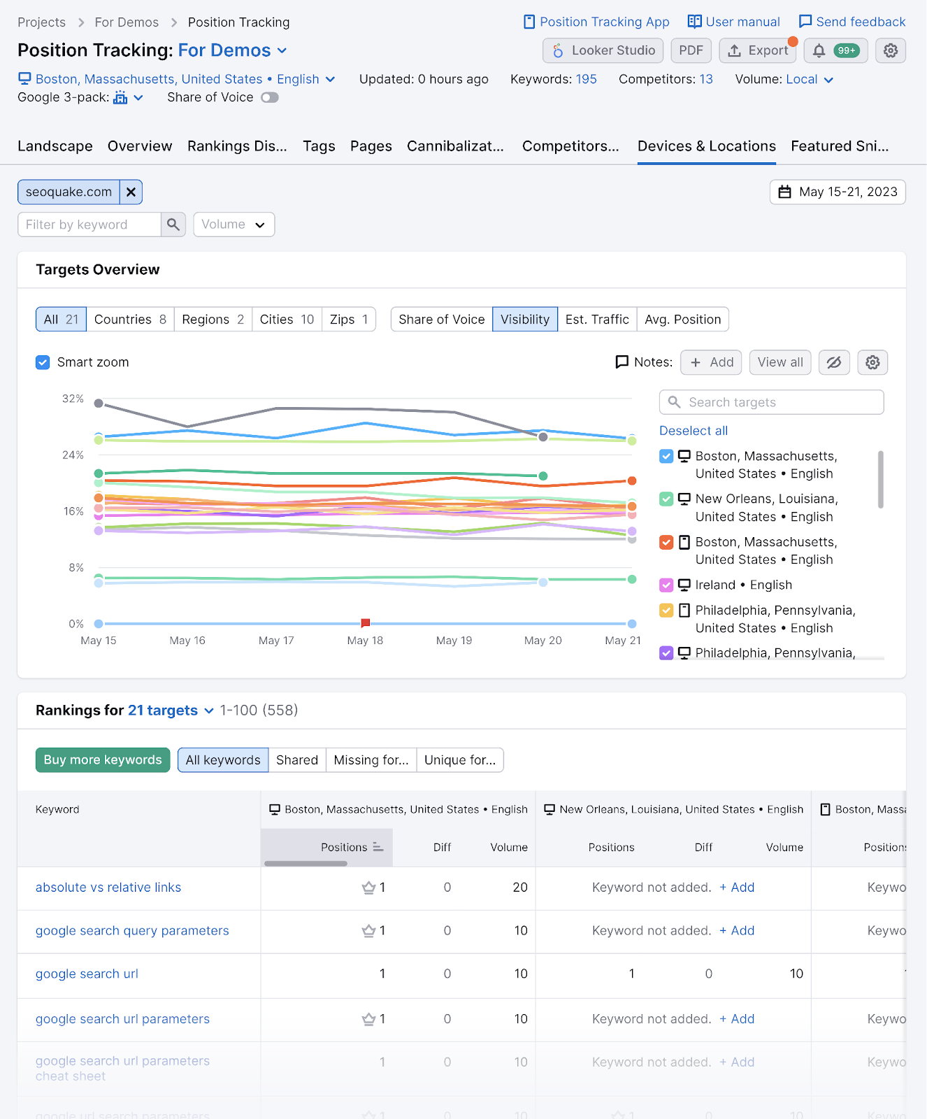
Monitor Results and Keep Optimizing
Your site’s local keyword rankings will regularly change. For any number of reasons. And when your rankings decline, traffic to your site can decrease. Which can potentially hurt your business. That's why you need to monitor your progress as part of your local SEO strategy. A great way to do that is to use Position Tracking. It allows for local keyword tracking down to the ZIP code level. And with SERP features tracked.

Slide 23
Local SEO Statistics
97% of people search online to learn about a local company or organization
35% of businesses say that local SEO is important for them.Local business listings contain incorrect information 50% of the time, according to business owners.On average, 28% of local searches end in a purchase within 24 hours
76% of people end up visiting a business within 1 day of searching for something nearby.

Slide 24
References
Books and Journals
Eric Enge, Stephan Spencer, Rand Fishkin, Jessie C Stricchiola, “The Art of SEO : Mastering Search Engine Optimization”, O'Reilly Media, October,2009.
https://www.semrush.com/blog/what-is-local-seo/
Fhttps://www.startupgeeks.it/wp-content/uploads/2018/12/ebook-seo-sej-complete-guide-2018.pdf
Video Link-
https://www.youtube.com/watch?v=bLUkIgY8MTE&list=PLjVLYmrlmjGdNxIBIdaDEHtI4gAxaYoq1&ab_channel=WsCubeTech
https://www.youtube.com/watch?v=83RXYrqRLeM&list=PLNfnAKZ4Zsar3Jwb59D0dJeQ-RnsaqpoT&ab_channel=UmarTazkeer
Web Link-
https://www.geeksforgeeks.org/search-engine-optimization-seo-https://www.tutorialspoint.com/seo/index.htm

